Slide 1
Textbook: Crafting a Compiler by Fischer, Cytron, and LeBlanc Pearson 2010 ISBN: 978-0-13-801785-9

Slide 2
Chapter 1
Introduction

Slide 3
Introduction
A compiler is a program that
accepts, as input, a program text in a certain programming language (source language),
and produces, as output, a program text in an assembly language (target language), which will later be assembled by the assembler into machine language.
This process is called compilation. (See Fig. 1.1).

Slide 4
Introduction (Cont.)

Slide 5
Front-end and Back-end
Front-end performs the analysis of the source language code to build the internal representation, called
intermediate representation (IR).
Back-end performs the target language synthesis to generate the target code (assembly code).

Slide 6
Machine Code Generated by Compilers
Pure machine code
Compiler may generate code for a particular machine’s instruction set without assuming the existence of any operating system or library routines.
Pure machine code is used in compilers for system implementation languages, which are for implementing operating systems or embedded applications.

Slide 7
Machine Code Generated by Compilers (Cont.)
Augmented machine code
Compilers generate code for a machine architecture that is augmented with:
1) operating system routines (aka system calls, window APIs) and
2) runtime language support routines.

Slide 8
Machine Code Generated by Compilers (Cont.)
Virtual machine code
Compilers generate virtual machine code that is composed entirely of virtual machine instructions.
That code can run on any architecture for which a VM interpreter is available. For example, the VM for Java, Java virtual machine (JVM), has a JVM interpreter.
Virtual machine and a universal intermediate language is not a new idea. But it becomes acceptable now when CPUs are fast enough.
Portability is achieved by writing just one virtual machine (VM) interpreter for all the target architectures.
In different platform you will need a different VM interpreter

Slide 9
Bootstrapping
When the source language (e.g., L) is also the implementation language (e.g., L) and the source text to be compiled is actually a new compiler of the compiler itself,
Ex: 你有一個 C compiler X 在 x86 平台，此Compiler X 是以 C寫成的source code P，你現在在 ARM 沒有C compiler，所以你就將此C compiler 的 code generation 改成 ARM assembly code (or machine code)，然後將 source code P 當作輸入餵給自己 (X)
the process is called bootstrapping
(see Fig. 1.2)

Slide 10

Chicken & Egg problem

Slide 11
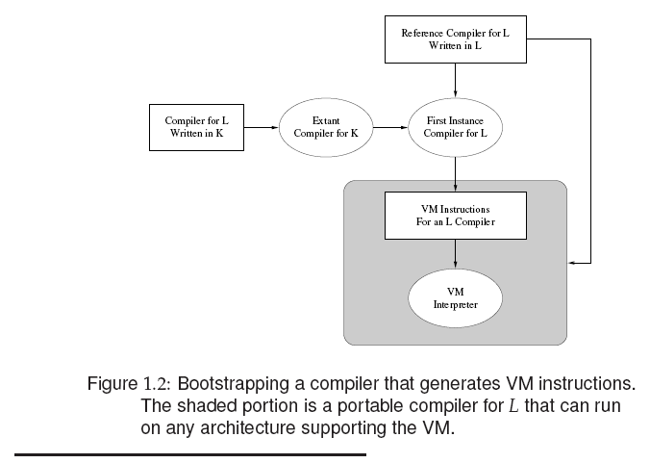


Many compilers for many programming languages are bootstrapped
TWISTED YOUR BRAIN

Slide 12
Compiler vs. Interpreter
Compiler has compilation and execution phases:
1) The compilation phase generates target
program from source program.
2) The execution phase executes the target
program.
Interpreter directly interprets (executes) the source program that reads inputs and writes outputs (Fig. 1.3).

Slide 13
Compiler versus Interpreter (Cont.)

Slide 14
Interpreter
An interpreter generally uses one of the following strategies for program execution:
execute the source code directly (LISP, BASIC)
translate source code into some efficient intermediate representation and immediately execute this (Perl, Python, MATLAB, and Ruby)
explicitly execute stored precompiled code[1] made by a compiler which is part of the interpreter system (UCSD Pascal)
Small talk, contemporary basic, Java combines 2 and 3

Slide 15
Organization of a Compiler
Compilers generally perform the following tasks:
1) Analysis of source program such as
scanning and parsing.
2) Synthesis of target program such as
code generation.

Slide 16
Organization of a Compiler (Cont.)
Source
Program
Scannerr
Tokens
Parser
AST
Type Checker
Decorated
AST
Translator
Intermediate
Representation
Symbol Tables
Optimizer
Intermediate
Representation
Code Generator
Target Code
Revised Figure 1.4: A syntax-directed compiler. AST denotes the Abstract
Syntax Tree.

Slide 17
Organization of a Compiler (Cont.)
Scanner
The scanner begins the analysis of the source program by reading the input text (character by character) and grouping individual characters into tokens such as identifiers and integers.
Parser
The parser is based on a formal syntax specification such as context free grammar (CFG).
The parser usually builds an abstract syntax tree (AST) as a concise representation of program structure.

Slide 18
Organization of a Compiler (Cont.)
Type checker (semantic analyzer)
The type checker checks and decorates the semantics of each AST code.
It checks type correctness, reachability and termination, and exception handling.

Slide 19
Organization of a Compiler (Cont.)
Translator
If an AST node is semantically correct, it can be translated into IR code (such as byte code in Java) that correctly implements the meaning of the program.

Slide 20
Organization of a Compiler (Cont.)
Optimizer improves IR code’s performance.
The next example optimizes a matrix multiplication program
A=B*C (Fig. 14.1) in 2 steps:
1) Fig.14.2 in-lines 2 methods (* and =) to avoid the overhead of method call.
2) Fig.14-3 fuses the outer two loops (for i , for j) and
eliminates the “Result” matrix.

Slide 24
Organization of a Compiler (Cont.)
Code generator
Mapping the IR code (such as Java byte code) or abstract syntax tree into target code (assembly code).

Slide 25
Homework
4. One of the most important tasks of a compiler is detecting incorrect or illegal
program components. Some errors are detected at compiler-time. Thus the
statement a=b/0; would be marked as containing an illegal divide operation.
Other errors are detected at run-time. Thus give:
c=0;
a=b/c;
an illegal division would be detected as the program executes.
One difference between compiler-time and run-time errors is that run-
time errors are only detected if the illegal code is actually executed.
Compiler-time errors make an entire program illegal, even if the
erroneous code is rarely or never reached.
Which approach do you recommend? Should a program with compiler-time
errors be allowed to execute, with termination only when illegal code is
executed? Are there any advantages to making a whole program illegal if some
illegal component of it might be executed?

Slide 26
No. 4 Solution
4. 1) Compile-time error is a better approach.
2) A program with compiler-time
errors SHOULD NOT be allowed to execute.
3) The advantage is that it ensures all the source codes are syntactically correct.

Slide 27
Homework (Cont.)
8. Most programming languages, such as C and C++, are compiled directly into the machine language of a “real” microprocessor (for example, an Inter x86 or Sparc). Java takes a different approach.
It is commonly compiled into the machine language of the JVM. The JVM is not implemented in its own microprocessor, but is instead interpreted on some existing processor. This allows Java to be run on a wide variety of machines, thereby making it highly platform independent.
Explain why building an interpreter for a virtual machine like the JVM is easier and faster than building a complete Java compiler. What are the disadvantages of this virtual machine approach?

Slide 28
No. 8 Solution
8. Building an interpreter for a virtual machine is easier than building a complete Java compiler is that there are fewer phases in developing interpreters.
The disadvantages of this virtual machine approach is that the source code must be compiled to byte code, and then a java interpreter can execute it. This takes more time.

Slide 29
Homework (Cont.)
11. C is sometimes called the universal
assembly language in light of its ability to be
very efficiently implemented on a wide variety
of computer architecture.
In light of this characterization, some compiler writers
have chosen to generate C code as their output
instead of a particular machine language.
What are the advantages to this approach to
compilation? Are there any disadvantages?

Slide 30
No. 11 Solution
11. Generating C code is more portable than generating an assembly code for a particular machine language.
However, the source code will be translated into C code, and then to assembly code. This is time-consuming.

